Slide 1
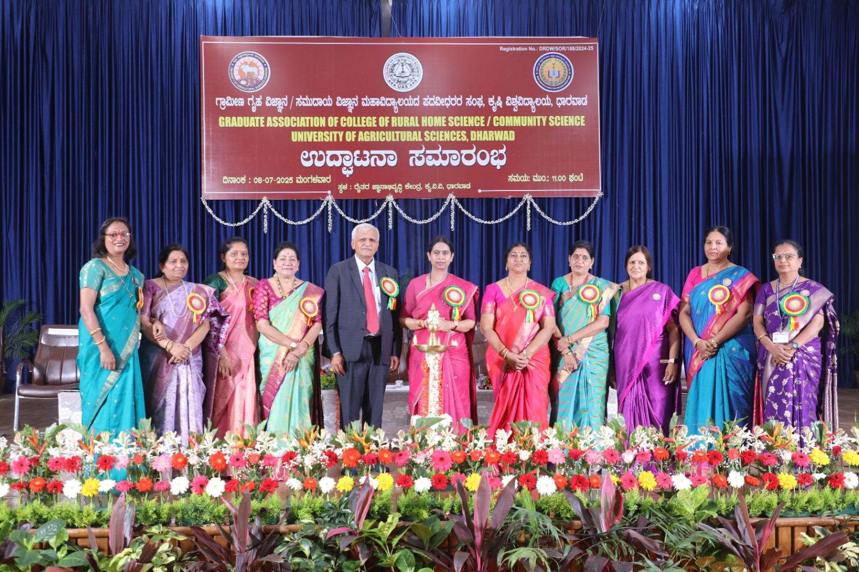
Inauguration of Graduate Association of College of Rural Home Science/ Community Science, University of Agricultural Sciences, Dharwad

Slide 2
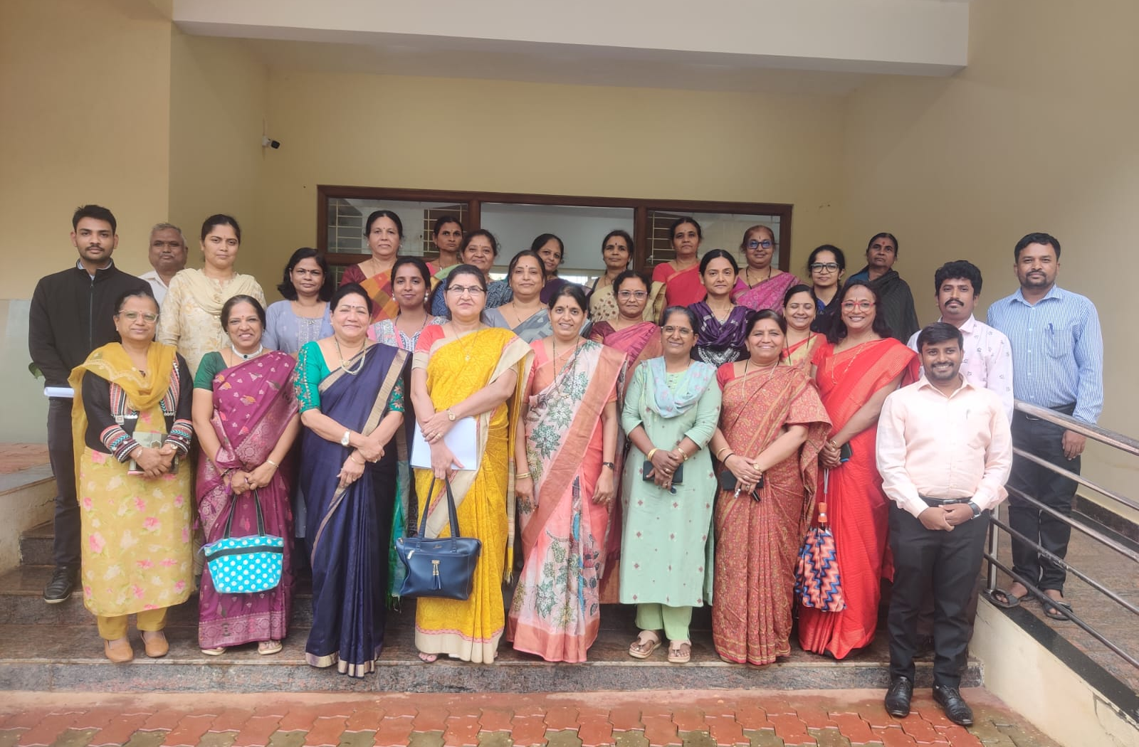
Visited by Dr. (Mrs.) Seema Jaggi, Assistant Director General (HRD), Agricultural Education Division, ICAR, New Delhi on 25/07/2025

